Slide 1

Digital portfolio
Student name:
Divya T
01
Register no and NMID:
2422k1437 and divyatnm2422k1437@gmail.com
02
03
Department:
B. Sc computer science
04
College :
Government Arts and Science college,
Bharathiyar university

Slide 2
Project title
Digital portfolio

Slide 3

AGEND
1.Problem Statement
2.Project overview
3.End Users
4.Tools and technologies
5.Portfolio design and layout
6.Features and Functionality
7.Results and 8.Screenshots
9.Conclusion
10.Githup Link

Slide 4

01
Problem Statement
A project problem statement is a clear and concise written document that describes a specific issue, need, or opportunity your project aims to address. It serves as a foundation for a project by defining the gap between the current and desired situation, provides context, establishes project goals, and helps stakeholders stay focused on a common objective without proposing a specific solution.

Slide 5
02
a concise, one-page summary that provides a high-level framework for a project, outlining its goals, expected outcomes, key deliverables, timeline, resources, budget, and success criteria
Project Overview
a concise, one-page summary that provides a high-level understanding of a project's goals, objectives, scope, expected outcomes, and key details like timeline, budget, and necessary resources

Slide 6
03
WHO ARE THE END USERS?
the people or organizations who will actually use the project's final product or service, and can include frontline workers, managers, or even customers.
The people or organizations who will actually use the project's final product or service, and can include frontline workers, managers, or even customersp

Slide 7

04
TOOLS AND TECHNIQUES
Project tools are the software and instruments like Gantt charts, Kanban boards, and project management platforms that help execute tasks, while project techniques are the methodologies and strategies, such as Waterfall, Agile, and the Critical Path Method, that provide a framework for managing the project lifecycle. Effective project management uses a combination of these tools and techniques, tailored to the project's size and complexity, to plan, schedule, monitor progress, and ensure successful completion.

Slide 8

05
PORTFOLIO DESIGN
AND LAYOUT
curate only your best work samples, create a compelling narrative for each project, and structure your portfolio with key elements like a personal statement and resume to tell your professional story effectively.

Slide 9

06
FEATURES AND FUNCTIONALITY
defining project scope, managing tasks by breaking them into manageable units, tracking progress through schedules and milestones, allocating resources effectively, facilitating team communication, managing budgets and costs, and mitigating risks

Slide 10
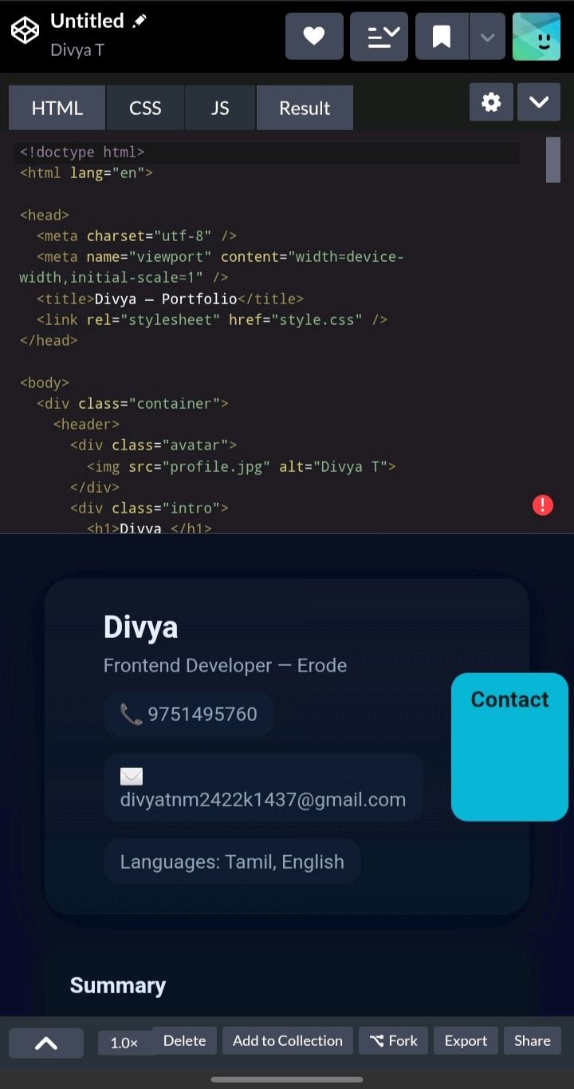
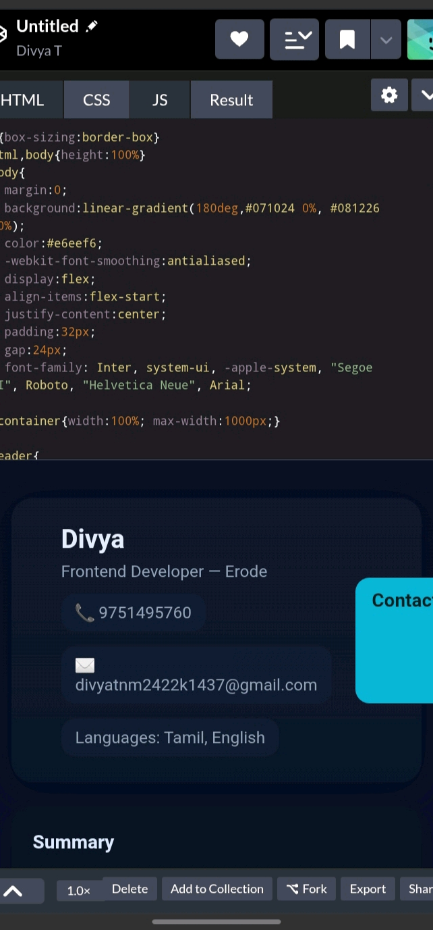
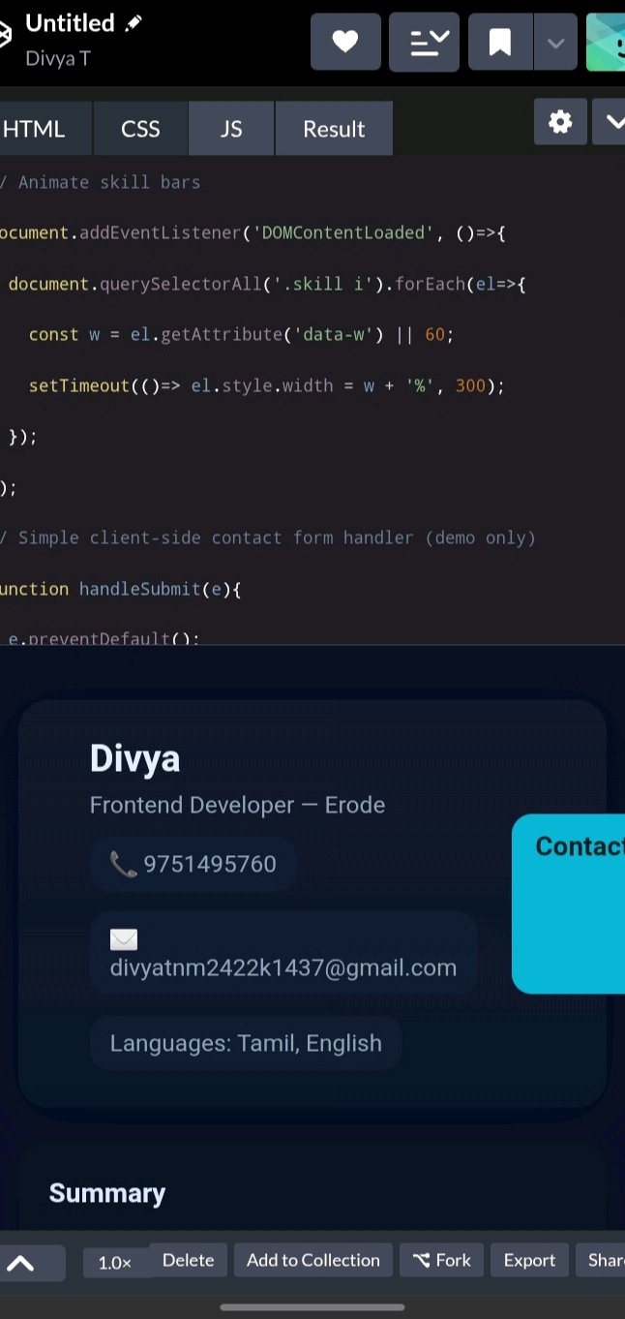
RESULTS AND SCREENSHOTS
HTML
CSS
JS

Slide 11
CONCLUSION
MY HEART IS WITH YOU
It was wonderful and learning experience for me while working on this project. This project. gave me real Insight into this. Project topic. This project full of thrill and joy taught me was joy and about various aspects of research and findings. Thank you for giving this project. I enjoyed every bit of doing it.

